Slide 1

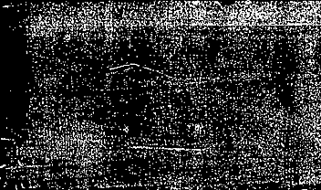

Software Engineering cs411, FALL 2025
Lectures 10: Design Principles IV by Dr. Mohamad Kassab
Leonidas Kontothanassis kthanasi@bu.edu

Slide 2

Lesson plan
Interaction Diagrams
In Class Exercise

Slide 3
Interactions Diagrams
During our discussions on GRASP patterns, we explained the concepts using ”Interaction Diagrams”.
These are your 4th type of UML diagrams you need to be familiar with in this course.

Slide 4
From Use Cases
Notes:
Operation contractions use a pre and post condition form to describe detailed changes to objects in a domain model
To create a contract – identify the system operations from the system sequence diagram

Slide 5

Use Case : Process Sale
Cashier selects MakeNewSale to begin a new sale.
System initializes a new, empty sale.
Cashier repeatedly invokes EnterItem for each product being purchased:
System looks up the product specification (price, description, etc.).
System creates a line item for the product in the current sale.
When there are no more items, Cashier invokes EndSale:
System calculates the total price and displays it.
Cashier invokes MakePayment:
System processes the payment (e.g., cash or electronic).
System records the payment and completes the sale.
System prints or displays a receipt for the Cashier and Customer.

Slide 6
SSD Example for use case : Process Sale
SSD’s are an almost direct translation of the UC scenario(s).
Each use case can be visually represented with one system sequence diagram.
The system sequence diagram shall focus on visually presenting the main success scenario of the use case.
Notes:
Example of a sequence diagram
what are the differences between a SSD and a sequence diagram?
An SSD is just a sequence diagram with one primary actor and an object called ":System". That is the only difference.
If the object is called ":System" and it is the only object.... then the diagram is a SSD. Else it is not.
Semantics: SSDs show the sequence of events between an actor and the whole system. A sequence diagram should show the objects in side the system do something.
Object lifeline
Sometimes objects are placed lower to show their creation height.

Slide 7
Domain Model is by RE based on all Use Cases
Records-sale-of
Described-by
1
Product
Product
Catalog
Contains
Specification
1
1..
*
description
price
1
UPC
Association
0..1
*
Used-by
Describes
Sales
*
*
LineItem
Store
Stocks
Item
quantity
1
address
1
*
1
1..
*
name
Concepts
Contained-in
Logs-
1
Houses
1
completed
1..
*
6
Sale
*
register
date
Started-by
Manager
Captured-on
1
1
time
1
Paid-by
1
1
Initiated-by
1
3
Records-sales-on
Attributes
1
1
1
Payment
Customer
Cashier
amount

Slide 8
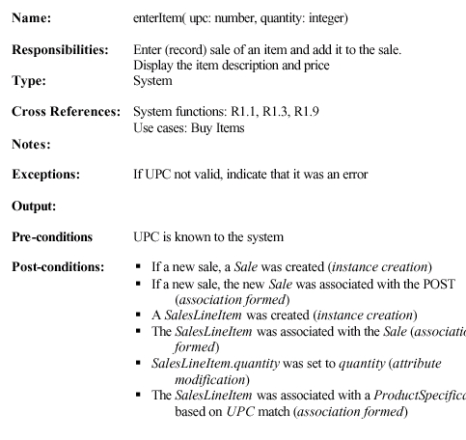
Operation Contract Example : for enterItem()
Operation Contracts are written for important system operations.
Each Operation Contract can be translated visually into one interaction diagram.
For example, in the next slide, we will show the interaction diagram that represents the operation enterItem()

Slide 10
More on Interaction Diagrams
Designer designs these operation contracts and interaction diagrams taking as an input:
All artifacts given by requirements engineer; specially the domain model
The importance to satisfy the GRASP Patterns where applicable
Can you try to find which GRASP Patterns were considered while designing enterItem()?

Slide 11

Object Communication
How do objects communicate with each other?
Interaction diagrams describe behavior, but the nature of the communication is implicit.
For an object to send a message to another, the receiver must be visible – the sender must have some kind of reference to the receiver.
Visibility is the ability of one object to see another.
Notes:
Reference (or pointer)
•Communication Diagrams show relationship between objects
•Sequence Diagrams focus on the time in which events occur
Visibility – see or have a reference to another object.

Slide 12
Attribute Visibility
B is visible to A if B is an attribute of A
Notes:
Take note of the Java class definition for POST, a POST instance may have attribute visibility to ProductCatalog, since it is an attribute of the POST class. This visibility is needed because in the enterItem method shown a POST instance needs to send the specification message to a ProductCatalog

Slide 13

In Class Exercise
Library Borrowing System

Slide 14


Readings , Assignments, Project Tasks
Read:
Chapters 9, 11, 12, 14 of the textbook.
Assignments & Project Tasks:
Assignment 2 is due on 4/3. This is an individual Assignment.

Slide 15

Questions?

